Slide 1

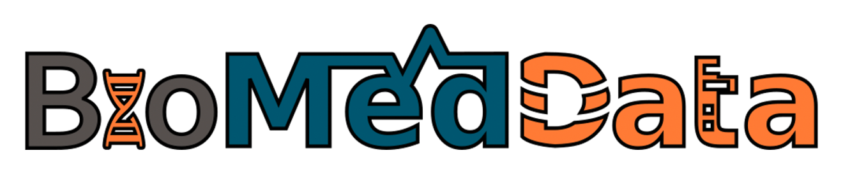
Metadata standards and controlled vocabularies
Federico Bianchini
Centre for Bioinformatics, University of Oslo
20 October 2023
Life Science RDM

Slide 2
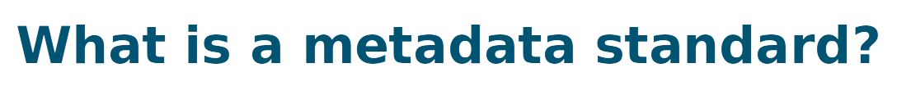
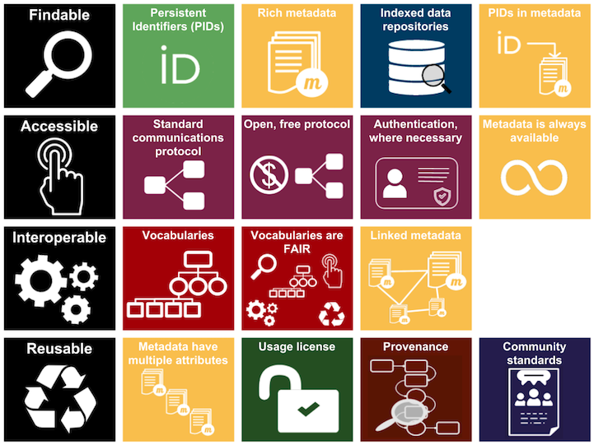
How does a standard make data more FAIR?
What are the ingredients required for defining a standard?
Where to find metadata standards?
Which tools can be used in connection with standards?
FAIR illustrations icons from ARDC 2018 licensed under Creative Commons Attribution 4.0 International License

Slide 3
The metadata requires a persistent identifier
Metadata standard compliant with repositories checklist
Metadata fields used to identify/retrieve the data
Persistency of metadata (also when the data is not available)

Slide 4
Interoperability fully relies on metadata
Vocabularies and ontologies ensure that standards are FAIR
A well-defined standard can be linked with standards describing other type of data
Focus on machine-actionability

Slide 5



Richer metadata fields enhance reusability
Metadata should describe data provenance
Everything needs to follow community standards
  Alignment with repository
MINSEQE
MIAME
...
HUPO-PSI
TraML
MIAPE
...
SRA-XML

Slide 6

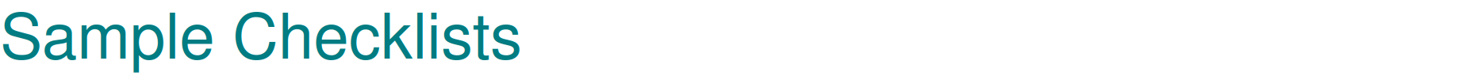
There is a minimum amount of information required during ENA sample registration and all samples must conform to a defined checklist of expected metadata values. The most suitable checklist for sample registration depends on the type of the sample.
https://www.ebi.ac.uk/ena/browser/checklists

Slide 7

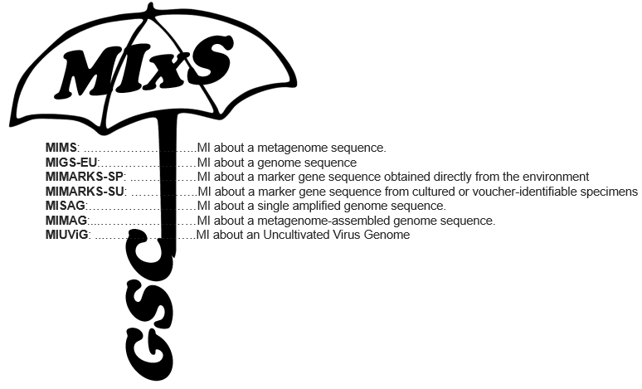
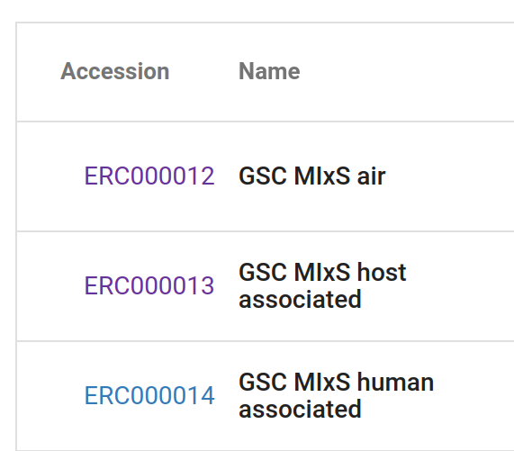
https://www.ebi.ac.uk/ena/browser/checklists
https://www.gensc.org/pages/standards-intro.html

Slide 8
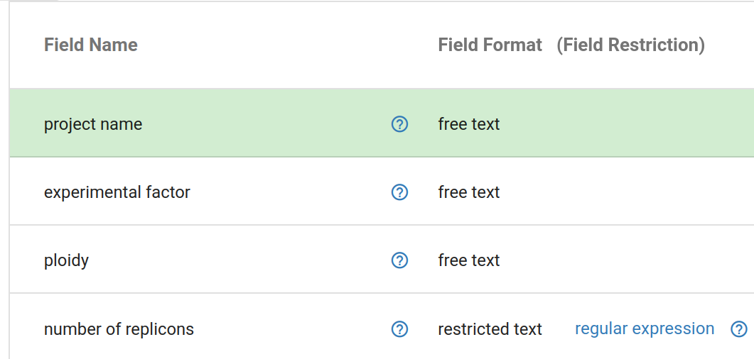
https://www.ebi.ac.uk/ena/browser/checklists

Slide 9
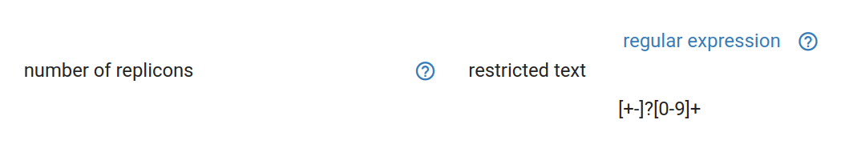
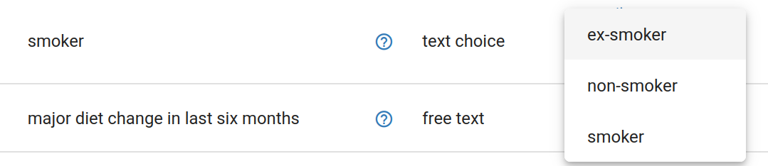
https://www.ebi.ac.uk/ena/browser/view/ERC000014

Slide 10
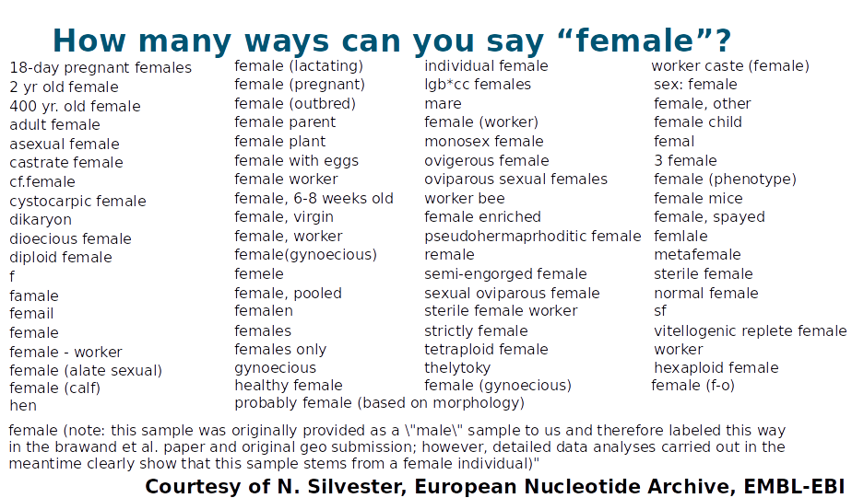
Controlled Vocabularies
These lists of pre-selected answers for a metadata field are known as controlled vocabularies. They are useful to avoid situations such the one below, where things got out of control

Slide 12
Ontologies
While controlled vocabularies offer more control over free text boxes, this solution is not ideal as different data sources could use different options with e.g. a different granularity.
The way to address this is to replace words in this list with persistent identifiers provided by an external sources. This would enable cross-linking between data resources i.e. interoperability

Slide 13
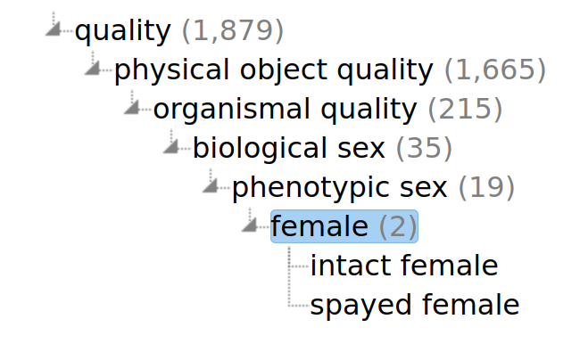
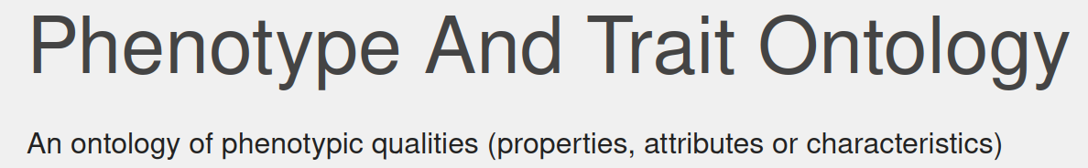
Ontologies
Granularity is very important to find the right terminology. Using a well-defined hierarchy usually helps finding the right information.
PID
http://purl.obolibrary.org/obo/PATO_0000383
https://www.ebi.ac.uk/ols4/ontologies/pato/classes/http%253A%252F%252Fpurl.obolibrary.org%252Fobo%252FPATO_0000383

Slide 14
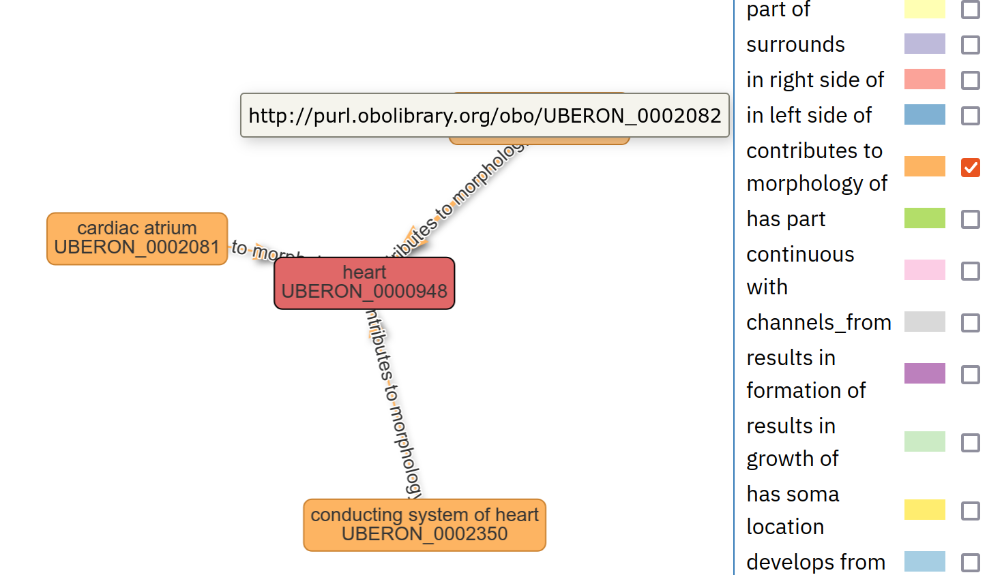
Ontologies
On top of the hierarchy, formal relations between terms are also relevant to interlink data
These can be visualised as graphs
Uber-anatomy ontology
https://www.ebi.ac.uk/ols4/ontologies/pato/classes/http%253A%252F%252Fpurl.obolibrary.org%252Fobo%252FUBERON_0000948

Slide 15
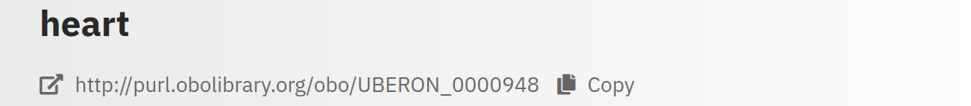
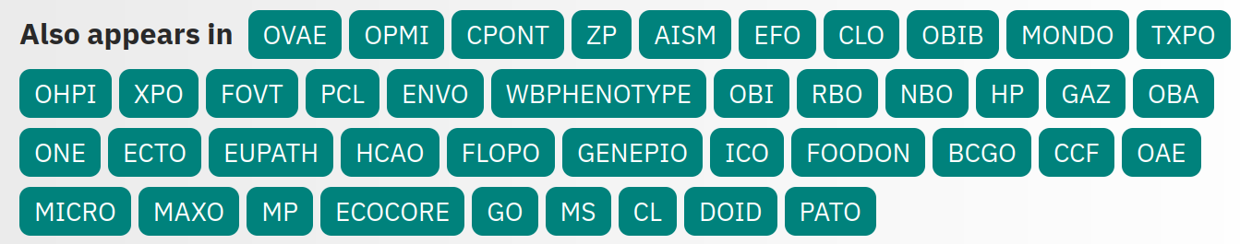
Ontologies
Cross-linking of terms across ontologies allows for an improved standardisation of terms and definitions.
https://www.ebi.ac.uk/ols4/ontologies/uberon/classes/http%253A%252F%252Fpurl.obolibrary.org%252Fobo%252FUBERON_0000948

Slide 16
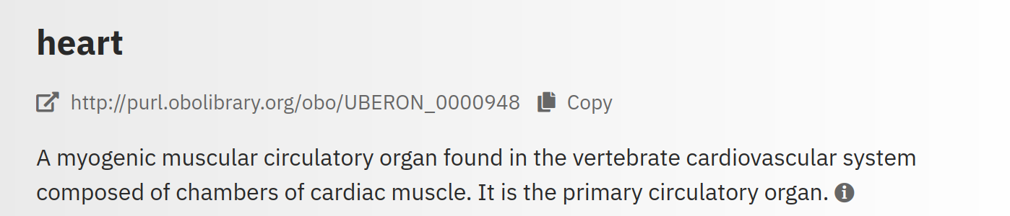
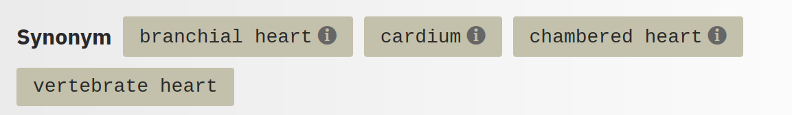
Ontologies
Definition and synonyms to facilitate search functionalities.

Slide 17



Ontologies
To summarise, an ontology is a set of concept and categories in a subject area that:
Shows and define properties
Shows the relation between these properties
Provides a persistent identifier to these properties
Follows a specific tree-like hierarchy
Is cross-linked with other ontologies

Slide 18
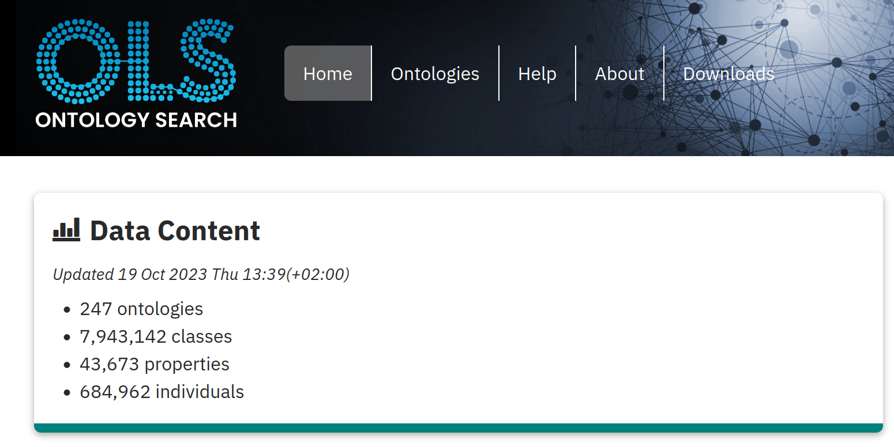
Ontologies - where to find them
https://www.ebi.ac.uk/ols4/

Slide 19
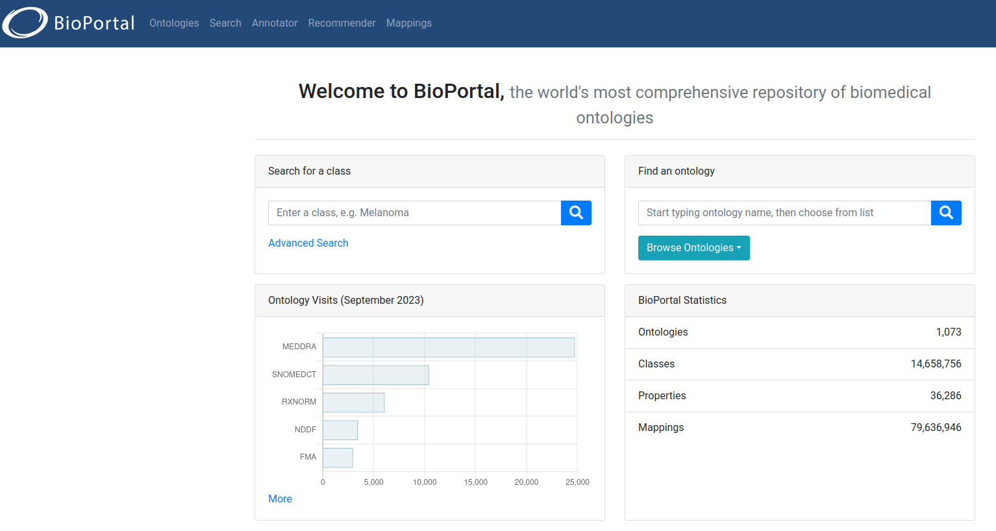
Ontologies - where to find them 2
https://bioportal.bioontology.org/

Slide 20

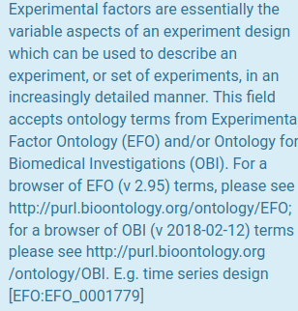
On ENA checklists, many “free text” boxes would actually require ontology terms.
How do I make sure at an early stage that I am collecting the right metadata?

Slide 21





Metadata tracking platforms
Domain specific:
COPO for plant sciences
MOLGENIS for biobanking
Omero for imaging data
Customisable (domain expertise required)
Proprietary ELNs/LIMS -
  often poor support for ontologies
openBIS - open source ELN/LIMS
FAIRDOM SEEK
https://copo-project.org/ https://www.molgenis.org/
https://openbis.ch/ https://seek4science.org/

Slide 22
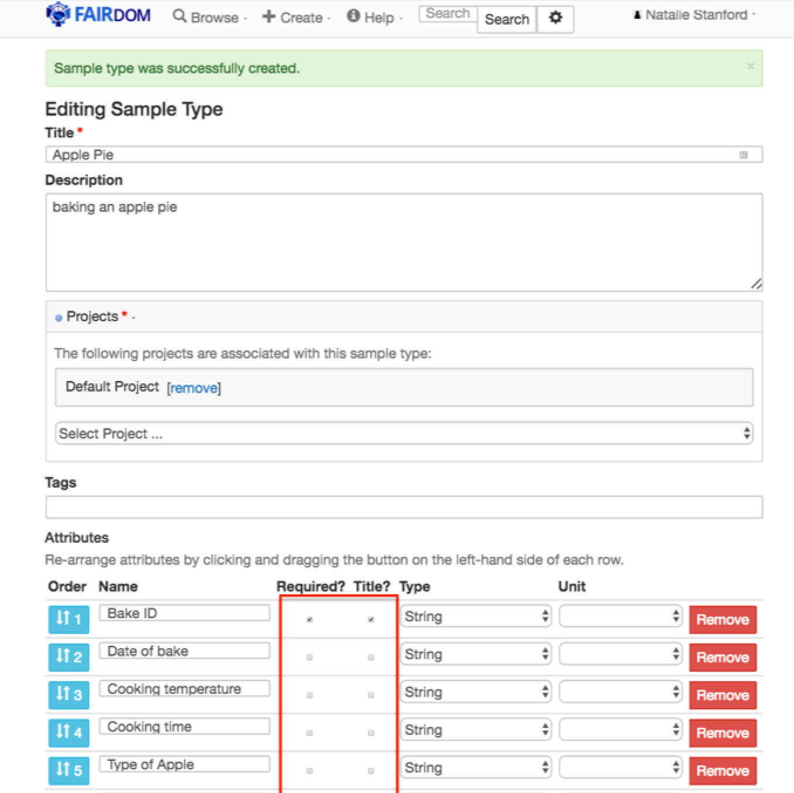

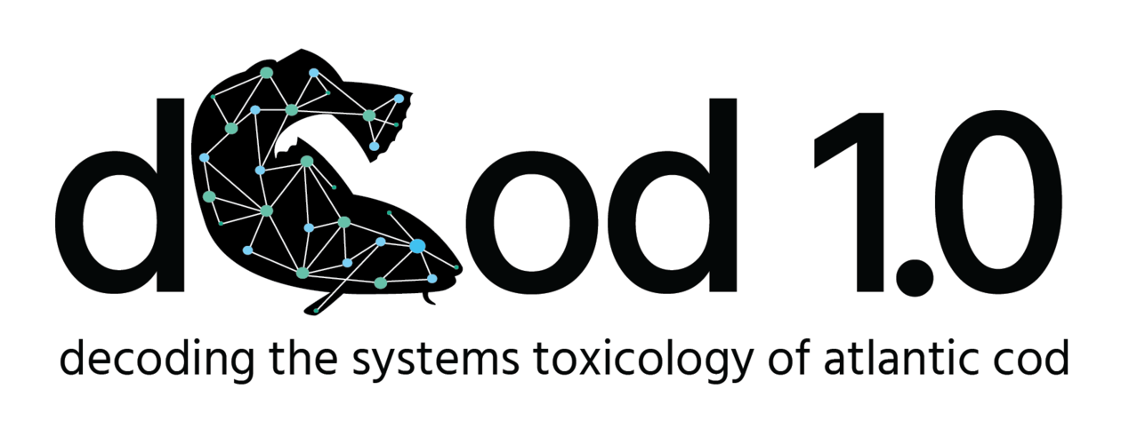


FAIRDOM SEEK
The SEEK platform is a web-based resource for sharing heterogeneous scientific research datasets, models or simulations, processes and research outcomes. It preserves associations between them, along with information about the people and organisations involved.
National users (via Digital Life):
Target new users (via ELIXIR)
Notes:
How we envision control of metadata

Slide 23
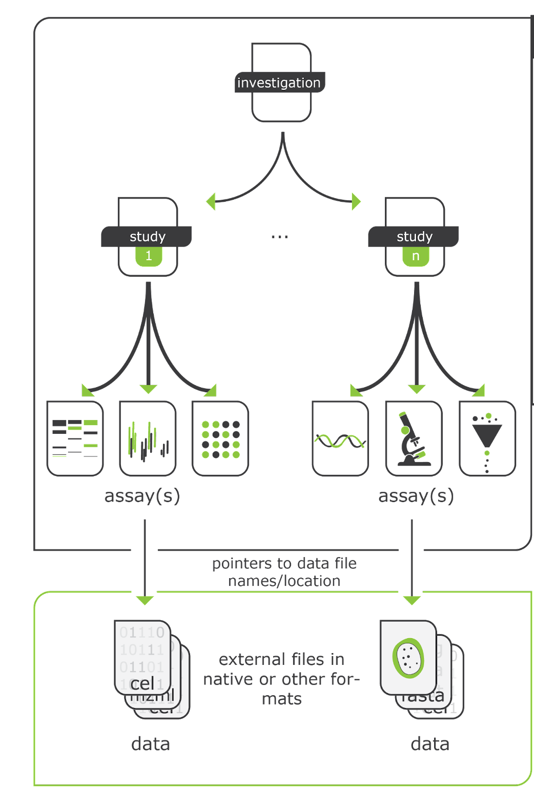

The ISA model
Investigation
Persons
Organizations
Publications
Study(s)
Design
Factor
Protocol
Assay(s)
Measurement
Technology
Materials
Data
Domain-agnostic standard with typical metadata fields for a project in the life sciences
Possibility of semantic annotations

Slide 24

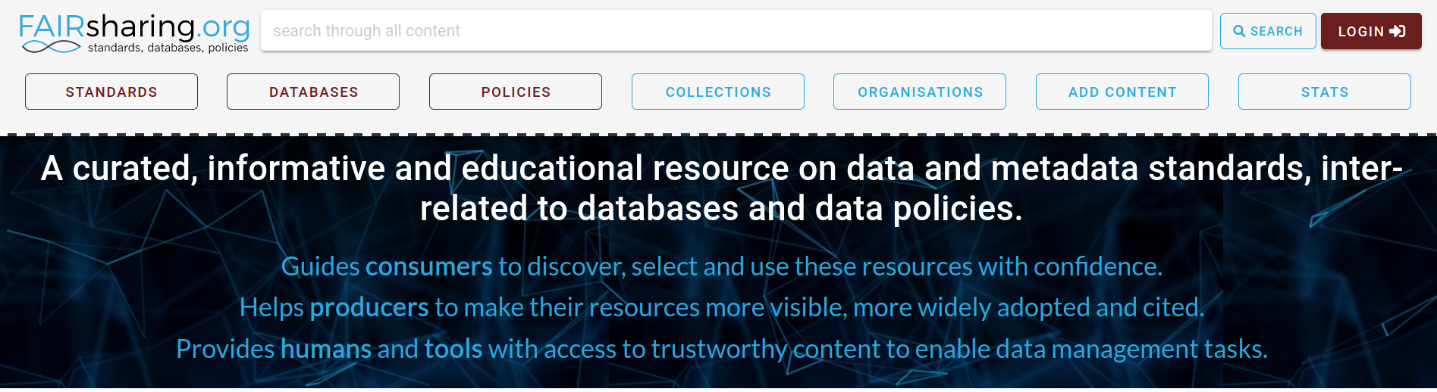
Standards and repositories - where to find them
Live demonstration of search capabilities
https://fairsharing.org/

Slide 25

Thank you!
elixir-norway.org
@elixirnorway
support@elixir.no
Except where otherwise noted, this work is licensed under a
Creative Commons Attribution 4.0 International License
https://creativecommons.org/licenses/by/4.0/

